Slide 1
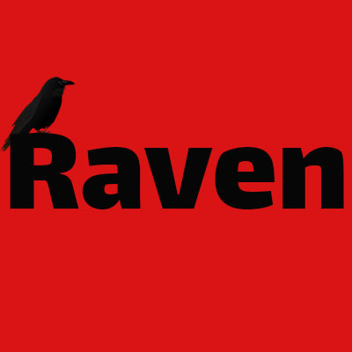
TEAM RAVEN
Presenting the Raven app

Slide 2
People are lazy, busy and choosy
People missed important news
Problem

Slide 3
Something that will check the news for you
It will text you when it comes and if it is relevant to you
Solution

Slide 4
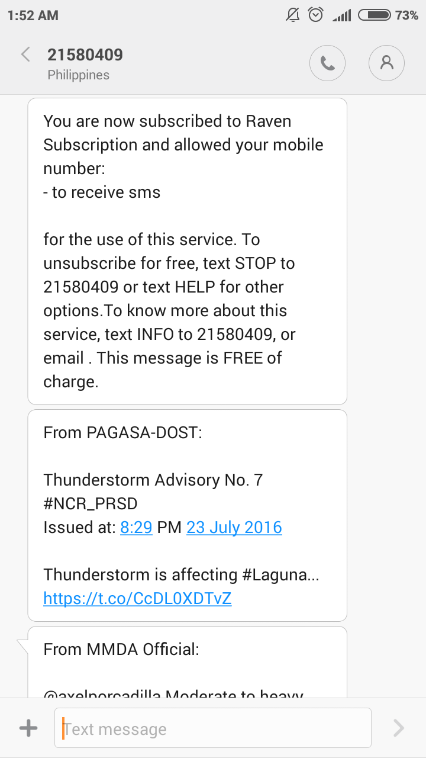
Raven is a simple platform that
automatically checks news from
online sources
People can subscribe to Raven and
if there is news that is relevant to
their location, the app will send
them an SMS using the Globe API
Product

